Slide 1
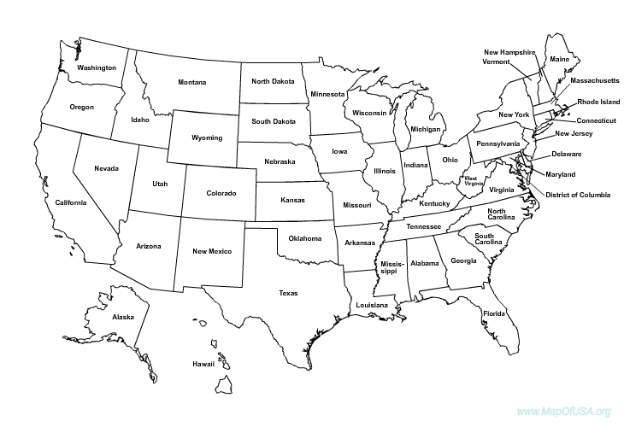
Number of Total Students by State Fall 2012
1
3
1
1
5
12
4
1
488
10
1
218
2
1
13
2
2
1
1114
1
79
696
14
3
3
4
2
1
57
120
157
1
1
29
5
7
3
1
9
2
1
1
1
17
10
2
2
290 International Students

